Slide 1
Transverse Motion
Eric Prebys, UC Davis

Slide 2
The Journey Begins…
We will tackle accelerator physics the way we tackle most problems in classical physics – ie, with 18th and 19th century mathematics!
As we discussed in our last lecture, the linear term in the expansion of the magnetic field is associated with the quadrupole, so let’s start there…

Slide 3
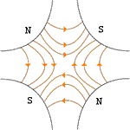
Quadrupole Magnets*
A positive particle coming out of the page off center in the horizontal plane will experience a restoring kick
*or quadrupole term in a gradient magnet

Slide 4
What about the other plane?
Defocusing!
Luckily, if we place equal and opposite pairs of lenses, there will be a net focusing regardless of the order.
➔pairs give net focusing in both planes -> “FODO cell”

Slide 5
General Approach
The dipole fields in our beam line will define an ideal trajectory.
The position along this trajectory (s) will serve as the independent coordinate of our system.
We will derive and explicit solution for equations of motion for linear focusing or defocusing effect due to deviation from this idea trajectory
Linear field gradients (quadrupole term)
Curvilinear coordinate system (centripetal term)
Everything else will be treated as a perturbation to this explicit solution

Slide 6
Formalism: Coordinates and Conventions
We generally work in a right-handed coordinate system with x horizontal, y vertical, and s along the nominal trajectory (x=y=0).
Define derivatives wrt s
Note: s (rather than t) is the independent variable

Slide 7
Initial Conditions and Phase Space
Our general equations of motion will have the form
These are 2nd order linear homogenous equations, so we need two initial conditions to fully determine the motion
“phase space”
unique initial phase space point ➔ unique trajectory

Slide 8
Transfer matrices
The simplest magnetic lattice consists of quadrupoles and the spaces in between them (drifts). We can express each of these as a linear operation in phase space.
By combining these elements, we can represent an arbitrarily complex ring or line as the product of matrices.
Quadrupole:
Drift:

Slide 9
Example: Transfer Matrix of a FODO cell
At the heart of every beam line or ring is the basic “FODO” cell, consisting of a focusing and a defocusing element, separated by drifts:
Can build this up to describe any beam line or ring
f
-f
L
L
Remember: motion is usually drawn from left to right, but matrices act from right to left!
Sign of f flips in other plane

Slide 10
Where we’re going…
It might seem like we would start by looking at beam lines and them move on to rings, but it turns out that there is no unique treatment of a standalone beam line
Depends implicitly in input beam parameters
Therefore, we will initially solve for stable motion in a periodic system.
The overall periodicity is usually a “ring”, but that is generally divided into multiple levels of sub-periodicity, down to individual FODO cells
In addition to simplifying the design, we’ll see that periodicity is important to stability
Our goal is to de-couple the problem into two parts
The “lattice”: a mathematical description of the machine itself, based only on the magnetic fields, which is identical for each identical cell
A mathematical description of the ensemble of particles circulating in the machine (“emittance”);
Periodic “cell”

Slide 11
Periodicity
We will build our complete system out of “cells”, assuming each one to be periodic
Example: FODO cell
Periodicity condition
FODO
FODO
FODO
FODO
FODO
FODO
“circumference” = period of cell

Slide 12
Quick Review of Linear Algebra
In the absence of degeneracy, an nxn matrix will have n “eigenvectors”, defined by:
Eigenvectors form an orthogonal basis
That is, any vector can be represented as a unique sum of eigenvectors
In general, there exists a unitary transformation, such that
Because both the trace and the determinant of a matrix are invariant under a unitary transformation:

Slide 13
Stability Criterion
We can represent an arbitrarily complex ring as a combination of individual matrices
We can express an arbitrary initial state as the sum of the eigenvectors of this matrix
After n turns, we have
Because the individual matrices have unit determinants, the product must as well, so

Slide 14
Stability Criterion (cont’d)
We can therefore express the eigenvalues as
However, if a has any real component, one of the solutions will grow exponentially, so the only stable values are
Examining the (invariant) trace of the matrix
So the general stability criterion is simply

Slide 15
Example
Recall our FODO cell
Our stability requirement becomes
L
L
f
-f

Slide 16
Twiss Parameterization
We can express the transfer matrix for one period as the sum of an identity matrix and a traceless matrix
We require the second matrix to have Det()=1, so
The requirement that Det(M)=1 implies
We can already identify A=Tr(M)/2=cosμ, so we can identify B=sinμ and write
Note that
So we can identify it with i=sqrt(-1) and write
“Twiss Parameters”
not Lorentz parameters!!
➔ only two independent

Slide 17
Equations of Motion
General equation of motion
For the moment, we will consider motion in the horizontal (x) plane, with a reference trajectory established by the dipole fields.
Solving in this coordinate system, we have
Particle trajectory
Reference trajectory

Slide 18
Equations of Motion (cont’d)
Equating the x terms
Re-express in terms of path length s. Use
Rewrite equation
Note: s measured along nominal trajectory, v_{s} measured along actual trajectory

Slide 19
Equations of Motion
Expand fields linearly about the nominal trajectory
Plug into equations of motion and keep only linear terms in x and y
Looks “kinda sorta like” a harmonic oscillator

Slide 20
Comment on our Equations
We have our equations of motion in the form of two “Hill’s Equations”
This is the most general form for a conservative, periodic, system in which deviations from equilibrium small enough that the resulting forces are approximately linear
In addition to the curvature term, this can only include the linear terms in the magnetic field (ie, the “quadrupole” term)
K(s) periodic!

Slide 21
Comments (cont’d)
The dipole term is implicitly accounted for in the definition of the reference trajectory (local curvature ρ).
Any higher order (nonlinear) terms are dealt with as perturbations.
Rotated quadruple (“skew”) terms lead to coupling, which we won’t consider yet.

Slide 22
General Solution
These are second order homogeneous differential equations, so the explicit equations of motion will be linearly related to the initial conditions by
Exactly as we would expect from our initial naïve treatment of the beam line elements.

Slide 23
Piecewise Solution
Again, these equations are in the form
For K constant, these equations are quite simple. For K>0 (focusing), it’s just a harmonic oscillator and we write
In terms if initial conditions, we identify and write

Slide 24
For K<0 (defocusing), the solution becomes
For K=0 (a “drift”), the solution is simply
We can now express the transfer matrix of an arbitrarily complex beam line with
But there’s a limit to what we can do with this

Slide 25
Closed Form Solution
Our linear equations of motion are in the form of a “Hill’s Equation”
If K is a constant >0, then so try a solution of the form
If we plug this into the equation, we get
Coefficients must independently vanish, so the sin term gives
If we re-express our general solution
Consider only periodic systems at the moment
We’ll see this much later

Slide 26
Solving for periodic motion
Plug in initial condition (s=0➔Ψ=0)
Define phase advances over one period
and we have
But wait! We’ve seen this before…
This form will make sense in a minute

Slide 27
Twiss representation of a Period
We showed a flew slides ago, that we could write
We quickly identify
We also showed some time ago that a requirement of the Hill’s Equation was that
Phase advance over one period
β and γ always positive!
Super important!
Remember forever!

Slide 28
Solving for the Lattice Functions
If we calculate (or measure) the transfer matrix of a period, we can solve for the lattice functions at the ends
Sign of M₁₂ resolves sign ambiguity of sine function

Slide 29
Evolution of the Lattice Functions
If we know the lattice functions at one point, we can use the transfer matrix to transfer them to another point by considering the following two equivalent things
Going around the period, starting and ending at point a, then proceeding to point b
Going from point a to point b, then going all the way around the period
Recall:

Slide 30
Evolution of the Lattice functions (cont’d)
Using
We can now evolve the J matrix at any point as
Multiplying this mess out and gathering terms, we get

Slide 31
Examples
Drift of length L:
Thin focusing (defocusing) lens:

Slide 32
Betatron motion
Generally, we find that we can describe particle motion in terms of initial conditions and a “beta function” β(s), which is only a function of location in the nominal path.
x
Lateral deviation in one plane
s
The “betatron function” β(s) is effectively the local wavenumber and also defines the beam envelope.
Phase advance
Closely spaced strong quads -> small β -> small aperture, lots of wiggles
Sparsely spaced weak quads -> large β -> large aperture, few wiggles

Slide 33
Behavior Over Multiple Turns
The general expressions for motion are
We form the combination
This is the equation of an ellipse.
Area = πA²
Particle will return to a different point on the same ellipse each time around the ring.

Slide 34
Symmetric Treatment of FODO Cell
If we evaluate the cell at the center of the focusing quad, it looks like
Leading to the transfer Matrix
L
L
2f
-f
2f
Note: some textbooks have L=total length

Slide 35
Lattice Functions in FODO Cell
We know from our Twiss Parameterization that this can be written as
From which we see that the Twiss functions at the middle of the magnets are
recall
Flip sign of f to get other plane

Slide 36
Lattice Function in FODO Cell (cont’d)
As particles go through the lattice, the Twiss parameters will vary periodically:
β = max α = 0
➔maximum
β = decreasing α >0
➔focusing
β = min α = 0
➔minimum
β = increasing α < 0
➔defocusing
Motion at each point bounded by

Slide 37
Interlude: Some Formalism
Let’s look at the Hill’s equation again…
We can write the general solution as a linear combination of a “sine-like” and “cosine-like” term where
When we plug this into the original equation, we see that
Since a and b are arbitrary, each function must independently satisfy the equation. We further see that when we look at our initial conditions
So our transfer matrix becomes

Slide 38
Closing the Loop
We’ve got a general equation of motion in terms of initial conditions and a single “betatron function” β(s)
Important note!
β(s) (and therefore α(s) and γ(s)) are defined to have the periodicity of the machine!
In general Ψ(s) (and therefore x(s)) DO NOT!
Indeed, we’ll see it’s very bad if they do
So far, we have used the lattice functions at a point s to propagate the particle to the same point in the next period of the machine. We now generalize this to transport the beam from one point to another, knowing only initial conditions and the lattice functions at both points
Define “tune” as the number of pseudo-oscillations around the ring

Slide 39
We use this to define the trigonometric terms at the initial point as
We can then use the sum angle formulas to define the trigonometric terms at any point Ψ(s₁) as

Slide 40
General Transfer Matrix
We plug the previous angular identities for C₁ and S₁ into the general transport equations
And (after a little tedious algebra) we find
This is a mess, but we’ll often restrict ourselves to the extrema of β, where

Slide 41
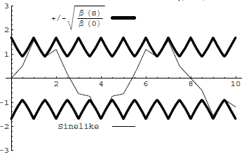
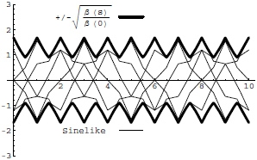
Conceptual understanding of β
It’s important to remember that the betatron function represents a bounding envelope to the beam motion, not the beam motion itself
Normalized particle trajectory
Trajectories over multiple turns
β(s) is also effectively the local wave number which determines the rate of phase advance
Closely spaced strong quads ➔ small β ➔ small aperture, lots of wiggles
Sparsely spaced weak quads ➔ large β ➔ large aperture, few wiggles

Slide 42
Betatron Tune
Particle trajectory
As particles go around a ring, they will undergo a number of betatrons oscillations ν (sometimes Q) given by
This is referred to as the “tune”
Ideal orbit
We can generally think of the tune in two parts:
6.7
Integer : magnet/aperture optimization
Fraction: Beam Stability

Slide 43
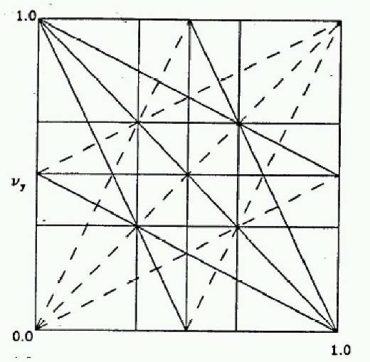
Tune, Stability, and the Tune Plane
If the tune is an integer, or low order rational number, then the effect of any imperfection or perturbation will tend be reinforced on subsequent orbits.
When we add the effects of coupling between the planes, we find this is also true for combinations of the tunes from both planes, so in general, we want to avoid
Many instabilities occur when something perturbs the tune of the beam, or part of the beam, until it falls onto a resonance, thus you will often hear effects characterized by the “tune shift” they produce.
“small” integers
➔Avoid lines in the “tune plane”
fract. part of Y tune
fract. part of X tune

Slide 44
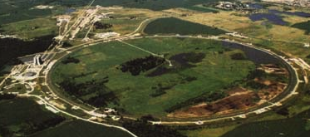
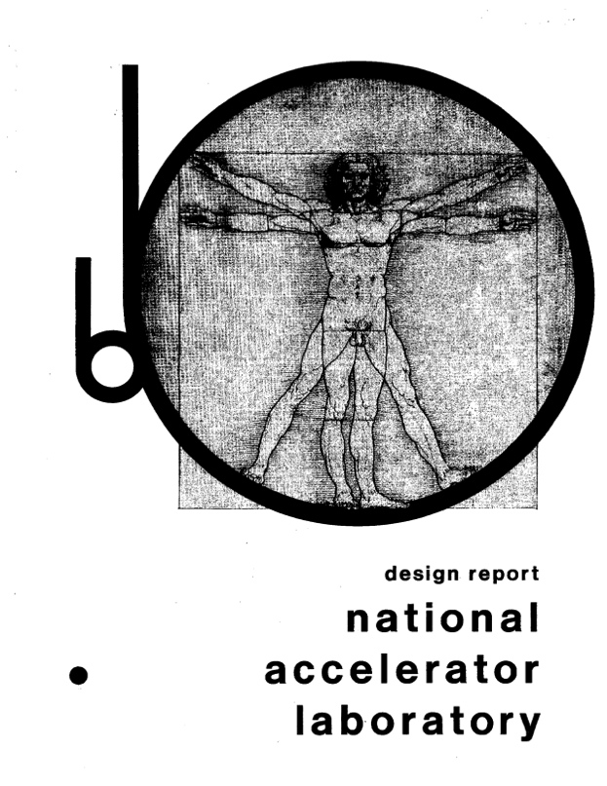
Example: Fermilab Main Ring
First “separated function” lattice
1 km in radius
First accelerated protons from 8 to 400 GeV in 1972
1968

Slide 45
Beam Parameters
The Main Ring accelerated protons from kinetic energy of 8 to 400 GeV*
Parameter | Symbol | Equation | Injection | Extraction
proton mass | m [GeV/c²] |  | 0.93827
kinetic energy | K [GeV] |  | 8 | 400
total energy | E [GeV] |  | 8.93827 | 400.93827
momentum | p [GeV/c] |  | 8.88888 | 400.93717
rel. beta | β |  | 0.994475 | 0.999997
rel. gamma | γ |  | 9.5263 | 427.3156
beta-gamma | βγ |  | 9.4736 | 427.3144
rigidity | (Bρ) [T-m] |  | 29.65 | 1337.39
*remember this for problem set

Slide 46
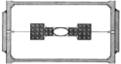
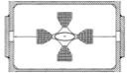
Cell Parameters
From design report
L=29.74 m
Phase advance μ=71°
Quad Length l_{quad}=2.13 m
Beta functions (slide 36)
Magnet focal length
Quad gradient (slide 12)

Slide 47
Beam Line Calculation: MAD
There have been and continue to be countless accelerator modeling programs; however MAD (“Methodical Accelerator Design”), started in 1990, continues to be the “Lingua Franca”
98.4m (exact) vs. 99.4m (thin lens)
main_ring.madx
!
! One FODO cell from the FNAL Main Ring (NAL Design Report, 1968)
!
beam, particle=proton,energy=400.938272,npart=1.0E9;
LQ:=1.067;
LD:=29.74-2*LQ;
qf: QUADRUPOLE, L=LQ, K1=.0195;
d: DRIFT, L=LD;
qd: QUADRUPOLE, L=LQ, K1=-.0195;
fodo: line = (qf,d,qd,qd,d,qf);
use, period=fodo;
match,sequence=FODO;
SELECT,FLAG=SECTORMAP,clear;
SELECT,FLAG=TWISS,column=name,s,betx,alfx,bety,alfy,mux,muy;
TWISS,SAVE;
PLOT,interpolate=true,,colour=100,HAXIS=S, VAXIS1=BETX,BETY;
PLOT,interpolate=true,,colour=100,HAXIS=S, VAXIS1=ALFX,ALFY;
stop;
half quad
K1=1/(2f)/L
24.7m vs. 26.4m
build FODO cell
force periodicity
calculate Twiss parameters

Slide 48
Evolution if Twiss Parameters (slide 31)
Thin focusing (defocusing) lens
Drift

Slide 49
Digression: Intuitive vs. Counterintuitive
We have derived the generic transfer matrix to be
Which means a particle on the axis (x₀=0) with an angle x’=θ will follow a path given by
But a particle doesn’t “know” about lattice functions, so does this make sense

Slide 50
Example: Initial angle in a Drift Section
Before you knew anything about beam physics, you would have said
Now you would say
How can both of these be true?

Slide 51
Evolution of Phase Angle
v

Slide 52
Sine of Phase Angle

Slide 53
Examples: Different Initial Conditions

Slide 54
Characterizing an Ensemble: Emittance
If each particle is described by an ellipse with a particular amplitude, then an ensemble of particles will always remain within a bounding ellipse of a particular area:
Area = πε
Either leave the π out, or include it explicitly as a “unit”. Thus
microns (CERN) and
π-mm-mr (FNAL)
Are actually the same units (just remember you’ll never have to explicity use π in the calculation)
These are really the same

Slide 55
Definitions of Emittance
Because distributions normally have long tails, we have to adopt a convention for defining the emittance. The two most common are
Gaussian (electron machines, CERN):
95% Emittance (FNAL):
In general, emittance can be different in the two planes, but we won’t worry about that for now.

Slide 56
Emittance and Beam Distributions
As we go through a lattice, the bounding emittance remains constant
large spatial distribution
small angular distribution
small spatial distribution
large angular distribution

Slide 57
Distributions, Emittance, and Twiss Parameters
The relationship between the lattice functions, RMS emittance and moment distributions is
We can turn this around to calculate the emittance and lattice functions based on measured distributions

Slide 58
Adiabatic Damping*
In our discussions up to now, we assume that all fields scale with momentum, so our lattice remains the same, but what happens to the ensemble of particles? Consider what happens to the slope of a particle as the forward momentum incrementally increases.
If we evaluate the emittance at a point where α=0, we have
“Normalized emittance”
=constant!
*only true for protons!

Slide 59
Consequences of Adiabatic Damping
As a beam is accelerated, the normalized emittance remains constant
Actual emittance goes down down
Which means the actual beam size goes down as well
The angular distribution at an extremum (α=0) is
We almost always use normalized emittance for protons
betatron function
RMS emittance
95% emittance
v/c

Slide 60
Example: FNAL Main Ring Revisited
We normally use 95% emittance at Fermilab, and 95% normalized emittance of the beam going into the Main Ring was about 12 π-mm-mr, so the normalized RMS emittance would be
We combine this with the equations (slide 45), beam parameters (slide 47) and lattice functions (slide 48) to calculate the beam sizes at injection and extraction.
We have divided out the “π”

Slide 61
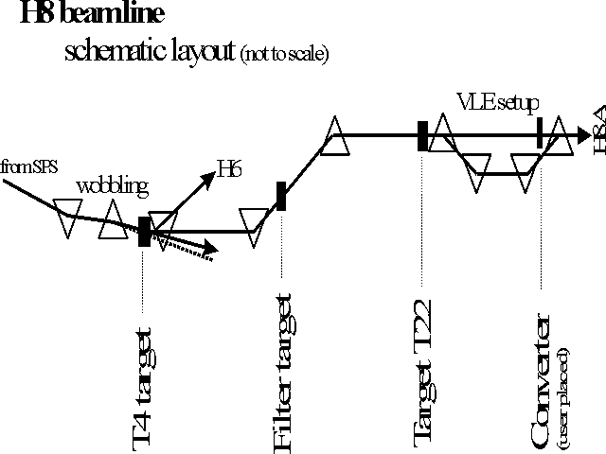
Beam Lines
In our definition and derivation of the lattice function, a closed path through a periodic system. This definition doesn’t exist for a beam line, but once we know the lattice functions at one point, we know how to propagate the lattice function down the beam line.

Slide 62
Establishing Initial Conditions
When extracting beam from a ring, the initial optics of the beam line are set by the optics at the point of extraction.
For particles from a source, the initial lattice functions can be defined by the distribution of the particles out of the source

Slide 63
Mismatch and Emittance Dilution
In our previous discussion, we implicitly assumed that the distribution of particles in phase space followed the ellipse defined by the lattice function
Once injected, these particles will follow the path defined by the lattice ellipse, effectively increasing the emittance
Lattice ellipse
…but there’s no guarantee
What happens if this it’s not?
Area = πε
Injected particle distribution
Effective (increased) emittance

Slide 64
Modeling FODO Cells in g4beamline
In spite of the name, g4beamline is not really a beam line tool.
Does not automatically handle recirculating or periodic systems
Does not automatically determine reference trajectory
Does not match or directly calculate Twiss parameters
Fits particle distributions to determine Twiss parameters and statistics.
Nevertheless, it’s so easy to use, that we can work around these shortcomings
Create a series of FODO cells
Carefully match our initial particle distributions to the calculations we just made.

Slide 65
Creating a Line of FODO Cells
We’ve calculated everything we need to easily create a string of FODO cells based on the Main Ring
Won’t worry about bends
Phase advance per cell = 71°, so need at least at least ~5 cells to see one betatron period. Let’s do 8.
First, create a quadrupole
# Main Ring FODO cell
param L=29740.
param QL=2133.3
param aperture=50. # Not really important
param -unset gradient=24.479
param -unset nCell=8
genericquad MRQuad fieldLength=$QL ironLength=$QL apertureRadius=$aperture ironRadius=5*$aperture kill=1
kill=1 saves time if you make a mistake!
Doesn’t really look like a real quadrupole, but the field is right and that’s all that matters.

Slide 66
Create string of FODOs
Create 8 cells by putting 16 of these, spaced 29740 mm apart, with alternating gradients (good practice for doing loops in g4bl).
If we put the first quad at z=0., the beam will start the middle of it. Is this what we want? Why or why not?
We create a Gaussian beam based on the parameters we calculated on Slide 50
We want to track the first hundred particles individually, so we add
We want to fit the distributions at regular intervals to calculate the beam widths and Twiss parameters. so we add the lines
Now run 1000 event (need enough for robust fits)
beam gaussian sigmaX=.682 sigmaXp=.00000686 sigmaY=.351 sigmaYp=.00001332 \
meanMomentum=$P nEvents=$nEvents particle=proton
trace nTrace=100 oneNTuple=1 primaryOnly=1
param totlen=2*$nCell*$L
profile zloop=0:$totlen:100 particle=proton file=main_ring_profile.txt

Slide 67
Analyze Output
The individual track information is written to the standard root output file in an Ntuple called “AllTracks”
The profile information is written to a text file. This can be read directly into histoRoot. I’ve provided a class (G4BLProfile) to load it into root*
We want to create a plotting space on which we can overlay several plots. The easiest way I know do to this is an empty 2D histogram.
Overlay a 3 sigma “envelope”, based on the fitted profiles
TFile ft("g4beamline.root");
TNtuple *t = (TNtuple *) ft.FindObjectAny("AllTracks");
G4BLProfile fp(filename);
TNtuple *p = fp.getNtuple();
TH2F plot("plot","Track Trajectories",2,0,sMax,2,-xMax,xMax);
plot.SetStats(kFALSE); //turn off annoying stats box
plot.Draw();
p->Draw("3*sigmaX:Z","","same");
p->Draw("-3*sigmaX:Z","","Same");
“same” option draws over existing plot
*http://home.fnal.gov/~prebys/misc/NIU_Phys_790/

Slide 68
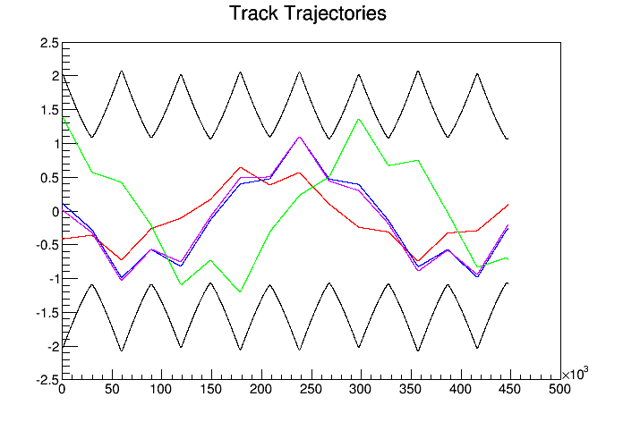
Plot Individual Tracks
t->SetMarkerColor(kRed); // These are points, not lines
t->Draw("x:z","EventID==1","same");
...

Slide 69
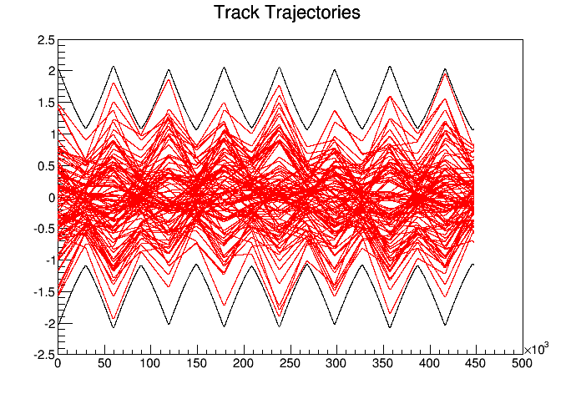
Envelopes
If we overlay all 100 tracks (remove “EventID” cut), we see that although each track has a periodicity of ~5 cells, the envelope has a periodicity of one cell..

Slide 70
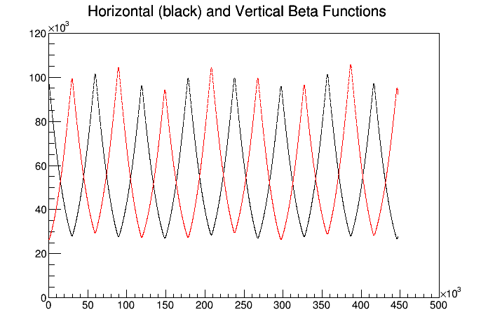
Lattice Functions
We can plot the fitted lattice functions and compare them to our calculations.
TH2F beta("beta","Horizontal (black) and Vertical Beta Functions",2,0.,sMax,2,0.,120000.);
beta.SetStats(kFALSE);
beta.Draw();
p->Draw("betaX:Z","","same");
p->SetMarkerColor(kRed);
p->Draw("betaY:Z","","same");
beta functions in mm!
slight mismatch because of thin lens approximation

Slide 71
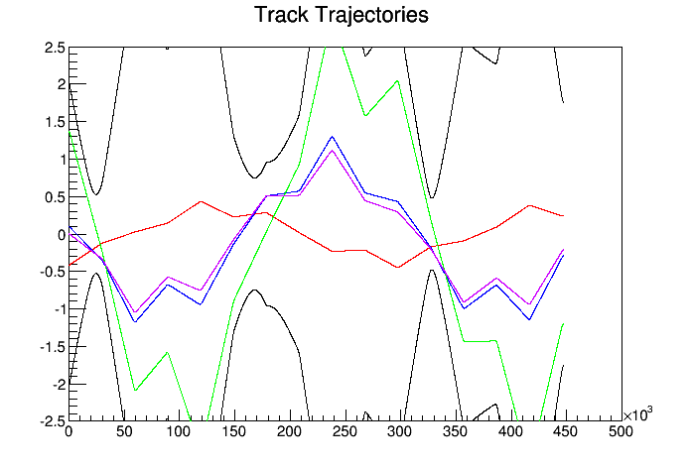
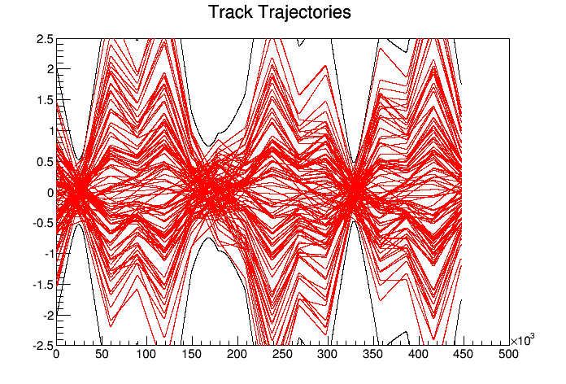
How Important is Matching?
In our example, we carefully matched our initial distributions to the calculated lattice parameters at the center of the magnet. If we start these same distributions just ~1m upstream, at the entrance to the magnet, things aren’t so nice.
Individual track trajectories look similar (of course)
Envelope looks totally crazy

Slide 72
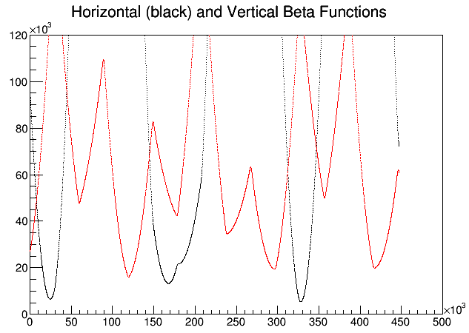
Mismatching and Lattice Parameters
If we fit the beta functions of these distributions, we see that the original periodicity is completely lost now.
Therefore, lattice matching is very important when injecting, extracting, or transitioning between different regions of a beam line!

